Slide 1

Google Cloud Powershell 101
@JONATHANMEDD
@PSSOUTHAMPTON

Slide 2
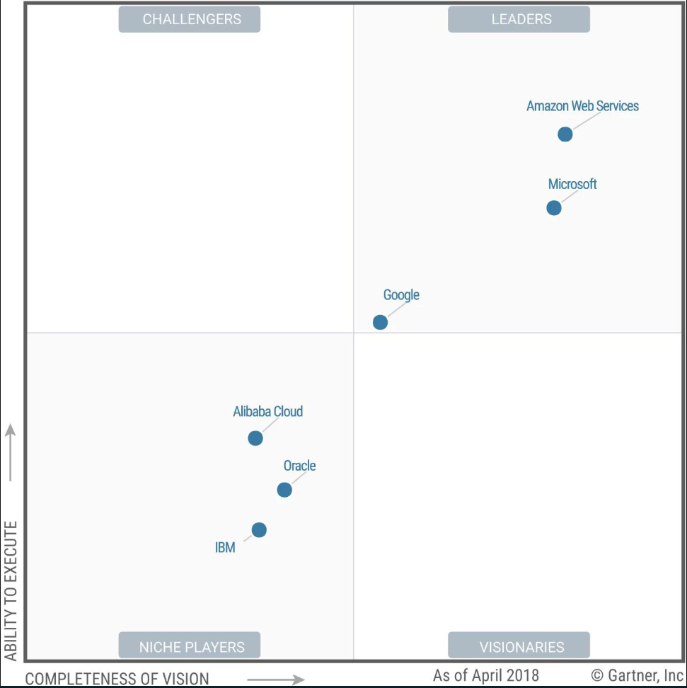
Public Cloud for IaaS: Current(ish) Market state - Gartner
6 horse race?
“Gartner was happy to drop eight clouds from this year’s (2018) Quadrant, farewelling Virtustream, CenturyLink, Joyent, Rackspace, Interoute, Fujitsu, Skytap and NTT”

Slide 3
Public Cloud for IaaS: Current(ish) Market state - Gartner
AWS:
“...is the most mature cloud and has come to be seen as a safe choice..“
“Customers should be aware that while it's easy to get started, optimal use — especially keeping up with new service innovations and best practices, and managing costs — may challenge even highly agile, expert IT organizations, including AWS partners. “
https://www.theregister.co.uk/2018/05/29/gartner_2018_magic_quadrant_for_infrastructure_as_a_service/

Slide 4
Public Cloud for IaaS: Current(ish) Market state - Gartner
Azure:
“... Azure is rated a fine choice and especially so for organisations already committed to Microsoft..“
“optimized to deliver ease of use to novices with simple projects which is great, but comes at the cost of sometimes making complex configurations difficult and frustrating to implement“
“Microsoft's sales, field solutions architects and professional service teams did not have an adequate technical understanding of Azure.”
https://www.theregister.co.uk/2018/05/29/gartner_2018_magic_quadrant_for_infrastructure_as_a_service/

Slide 5
Public Cloud for IaaS: Current(ish) Market state - Gartner
Google:
“... a solid choice even if its services aren’t yet as broad as rivals..“
“…positioned itself as the most cost-effective cloud, but its deepest negotiated discounts are usually limited to a single-year contract.“
“...some current customers sometimes cite ISV licensing and support challenges..”
https://www.theregister.co.uk/2018/05/29/gartner_2018_magic_quadrant_for_infrastructure_as_a_service/

Slide 6
First impressions of GCP
Appears to have the majority of the same offerings
UI is fairly basic; focus appears more on command line and REST API
Interesting pricing discounts based on sustained usage
Network is a key differentiator

Slide 7
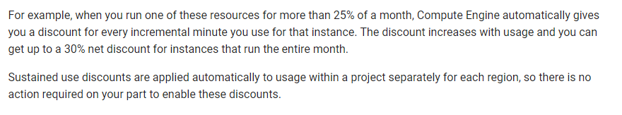
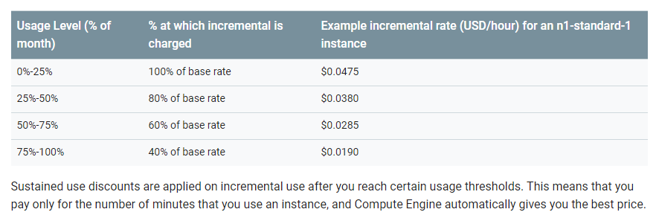
Sustained use discount
https://cloud.google.com/compute/docs/sustained-use-discounts

Slide 8
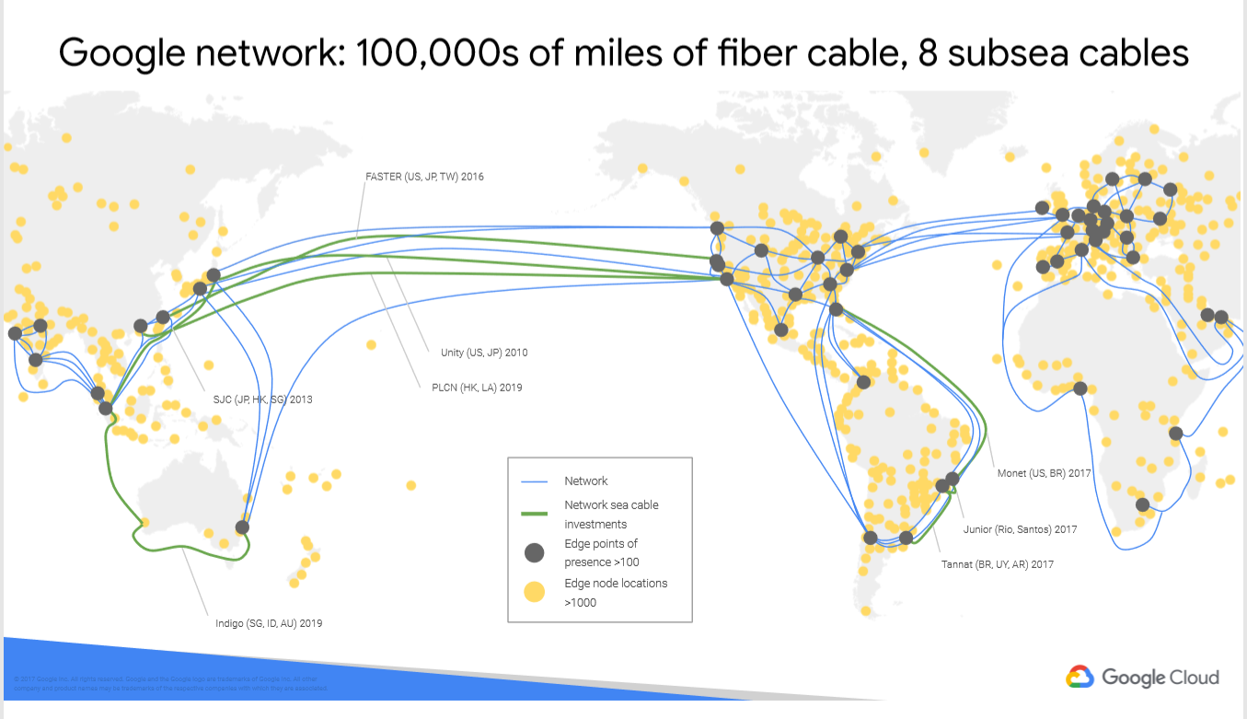
Global Network

Slide 9
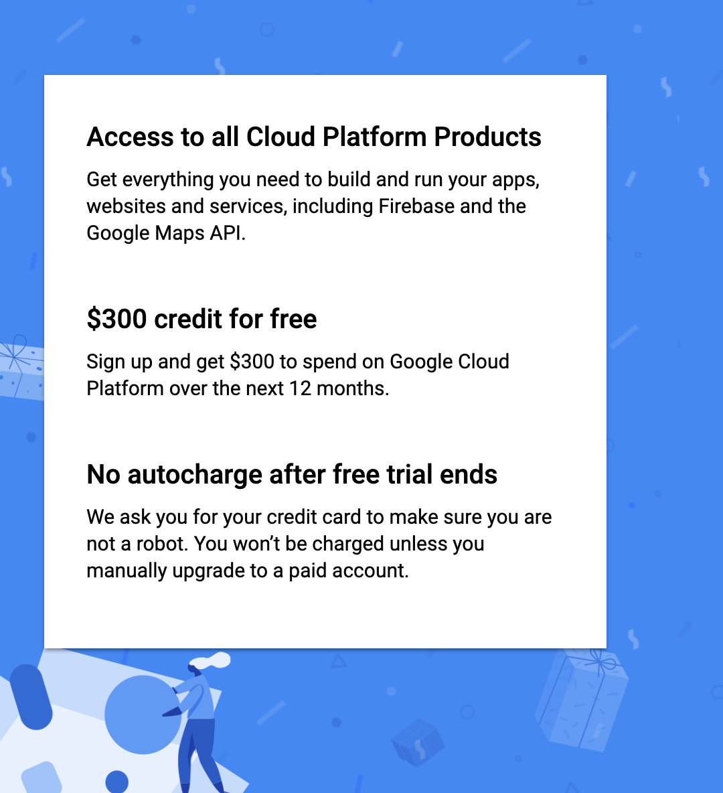
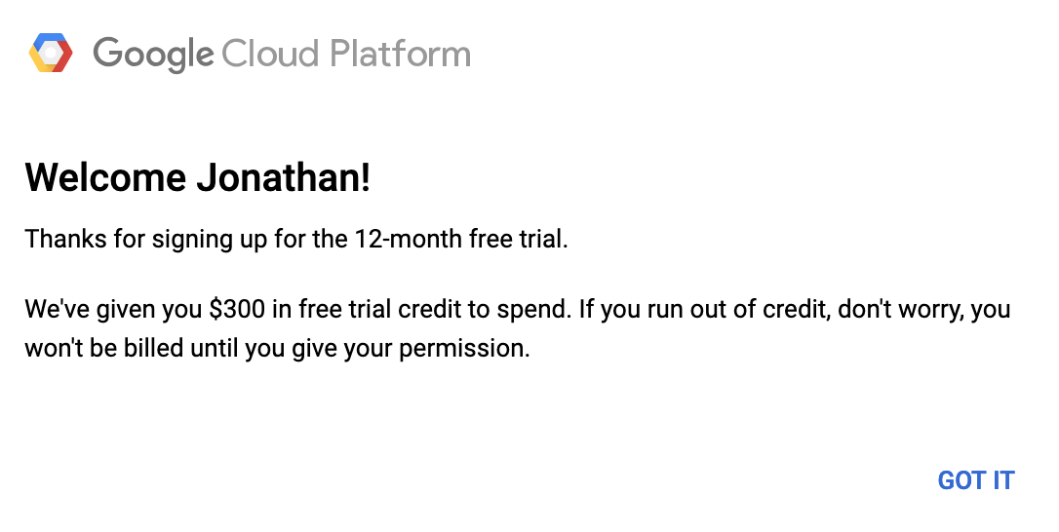
$300 Credit for TRIAL

Slide 10
Google Cloud Console
Demo
(Don’t forget to demo the website app)

Slide 11
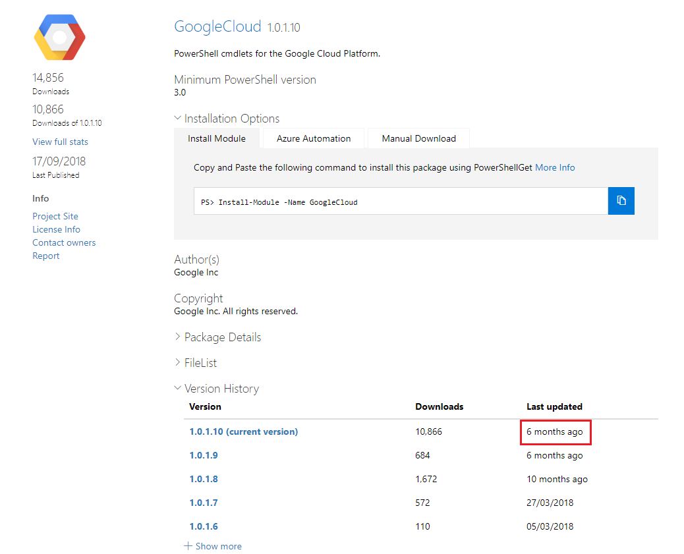
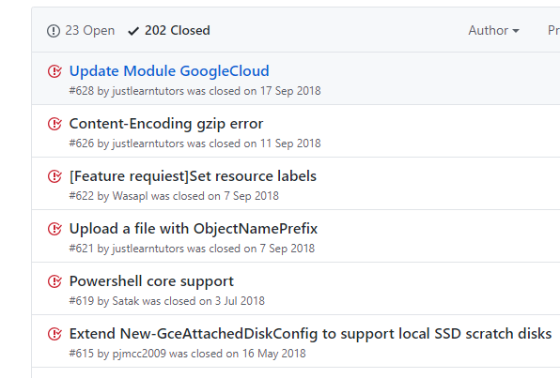
Google Cloud PowerShell module

Slide 12
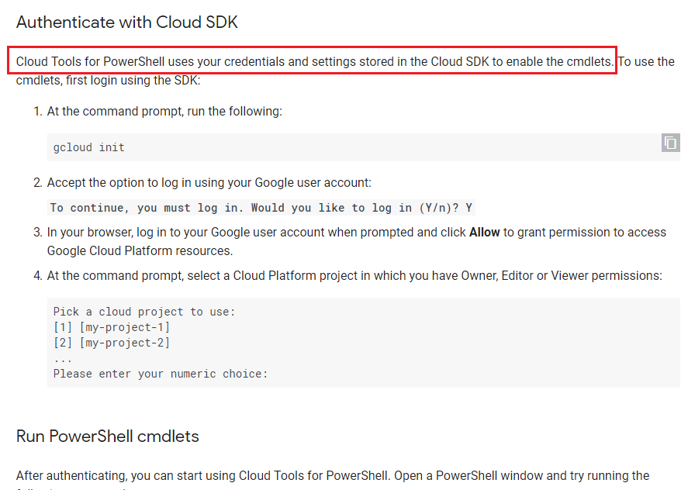
installation
Need gcloud sdk AND PowerShell cmdlets
https://cloud.google.com/tools/powershell/docs/quickstart

Slide 13
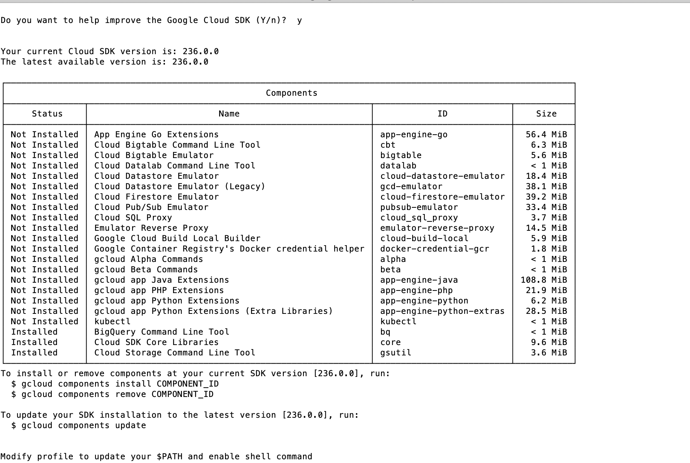
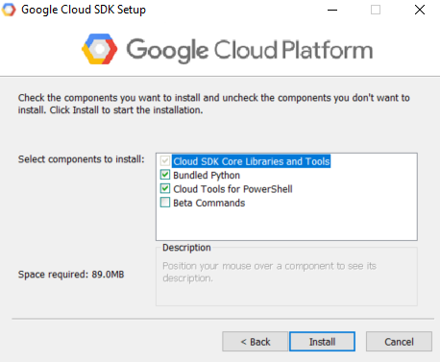
Installation

Slide 14
Google Cloud PowerShell Module
Demo

Slide 15
Google Cloud PowerShell Module
Examples can be found here: https://github.com/jonathanmedd/Presentations/tree/master/PowerShell/Google%20Cloud%20PowerShell%20101

Slide 16
Summary
PowerShell toolkit seems OK for basic use cases
May need to combine it with native gcloud command line tools
Future development appears to be in question

